Slide 3
Notes:
The Vision Statement is the touchstone for everything we do in World Services.

Slide 4
Notes:
NAWS stands for NA World Services. When we say “world services,” that means all of the elements of the service system at the world level—the World Service Conference, the World Board, who are elected by the Conference, and the World Service Office, whose activities are overseen by the World Board.
You can find more information about World Services from A Guide to World Services in NA. That’s where this diagram comes from.

Slide 5
Notes:
It is important to note that all of the entities in NA World Services are directly accountable, through our 9th Tradition, to the Fellowship that created them. This diagram is also from A Guide to World Services. It shows the connection of the groups to the World Service Conference, including some of the diversity that NA communities use to organize their services. This is a great diagram to use as a handout or slide if you need an overview of the structure from group to WSC.

Slide 6
Notes:
A Guide to World Services describes the basic purpose of NAWS as “communication, coordination, information, and guidance.” Some of our office staff call this CCIG, for short.
If NAWS had a mission statement, this would pretty much be it. Like the Vision Statement, this informs all of our work--the projects that we work on in each Conference cycle, as well as the kinds of work that continues week in and week out.
The five locations of NA World Services around the world spend over 90% of their time and resources on what we call essential services. That is primarily literature production and distribution; protecting the Fellowship’s intellectual property; and providing communication, coordination, information, and guidance to members and service bodies around the world..
In addition to that work, every two years, the World Service Conference approves a number of projects—this year there were six.
This last World Service Conference was kind of strange. It happened online for the first time ever, and it was held in two parts—the first in April and May and the second in August. So what we call the “cycle” is shorter than usual this time. That’s the time to work on projects between the end of the Conference and the drafting of the Conference Agenda Report for the next WSC. Even though it is a short cycle, we’ve made a lot of progress on some of the projects.

Slide 7
Notes:
The Local Service Toolbox is working on creating resources for Virtual Meetings. We have done a lot to collect and share information about virtual meetings and carrying the message effectively and virtually.
We’ve held five open webinars on the topic. We’ve also collected a lot of resources from trusted servants around the world. We had a survey posted for several months in 2020 collecting information on best practices. With the help of all of those conversations and resources and input, we are now taking the next steps for the project.
There will be two main focuses for the project moving forward. One will be best practices for virtual meetings, and the other will be how virtual meetings are connecting to the NA community and NA service delivery.
We have collected much information on the first focus, and last week we posted a draft outline for a tool or tools related to virtual meetings best practices. We plan to revise the outline regularly as we get input with the aim of publishing it as a resource for virtual meetings.
The second focus about service delivery and connecting to the NA community and service system seems to be one that most of NA is still “figuring out.” To help in that effort, we just posted another survey. It’s short, and will be online through the end of May. One of the questions the survey asks is whether you believe virtual meetings meet the criteria to be considered NA groups.
The results from the survey will help us frame a conversation with delegates that we hope will lead to some decisions at the next World Service Conference. We appreciate you taking the time to fill it out, and we hope you will share the link with your friends.

Slide 8
Notes:
That criteria is the six points listed in The Group Booklet
1. All members of a group are drug addicts, and all drug addicts are eligible for membership.
2. As a group, they are self-supporting.
3. As a group, their single goal is to help drug addicts recover through application of the Twelve Steps of Narcotics Anonymous.
4. As a group, they have no affiliation outside Narcotics Anonymous.
5. As a group, they express no opinion on outside issues.
6. As a group, their public relations policy is based on attraction rather than promotion.
You can find links to any current surveys by typing na.org/survey into your search bar, or by clicking on “Projects and Surveys” in the drop-down menu underneath “For Our Members” on the green toolbar.
We also have an easy web address for the local service toolbox project page: na.org/toolbox,
Reports and related resources from webinars, as well as a bunch of other useful resources, are all posted on the Virtual Meeting Resources page: na.org/virtual. This page has a table of contents at the top to make navigation easier. We post new materials here regularly.
One of the newest things on the page is a link to a new form for virtual meetings to share their details with us so that they can be added to the meeting locator and kept updated.
The process we have used for many years to gather information about in-person meetings has never been a good fit for virtual meetings, and this form is designed particularly for virtual meetings.
Another place on our website that you can find lots and lots of resources for groups and service bodies is the Local Service Resources page: na.org/localresources. If you have a resource or tool that others might benefit from, please send it to worldboard@na.org.

Slide 9
Notes:
Along with meetings moving online, another big change for NA brought about by the pandemic is the effect on finances.
For World Services, the effect has been dramatic. More than half the staff was furloughed last March, and it has motivated us to work toward a shift we’ve known for years that we’ve needed to make—from a reliance on literature sales for income to supporting service delivery through member contributions.
World Services is a business, clearly motivated and guided by a spiritual mission. We are driven not to make money, but to provide the services and support to move more towards our vision.
It takes resources – both human and financial - to do what we do—produce and distribute literature, oversee translations, maintain 5 locations, hold workshops and webinars, protect NA’s intellectual property, and to be a resource to the Fellowship.
We have known for a long time that relying on literature sales to fund services is not a sustainable model, and the global shutdowns really have just highlighted that reality.

Slide 10
Notes:
To get a complete picture of our financials, the best place to go is the annual report, which you’ll find at na.org/ar. Our fiscal year runs from the 1st of July 1st to the 30th of June. It takes time to close out our fiscal year, take inventory at all locations, and then have the auditors on-site to verify all of that information. Once the audit is finalized it goes to the World Board, and when they approve the audit, it is included in the Annual Report along with other detailed financial statements, including a summary of all contributions. That process means we typically publish an annual report 6 to 9 months after the end of the fiscal year so we are currently working on the Annual Report and waiting for the final audit report for the fiscal year ending June of 2020.
Most of our members want to see a simple financial report, but with 5 locations operating in 5 currencies and operating under different legal systems, that is not really possible. The closest we can get is the one-page financial position provided by our auditors.
We are currently operating on what we have called an emergency budget. The emergency budget took the proposed budget that had been provided in the Conference Approval Track for WSC approval and reduced most income by 25% and reduced expenses where we believed we were able to, given the contracts and leases we are obligated to. This emergency budget is only a plan and was developed very early in the global shut down and was approved at the virtual WSC 2020. We have done a pretty amazing job staying under all of the expenses outlined in that budget, with the exception of legal expenses and in-house production. We have provided Conference participants a full and detailed report of all NA World Services financial activities every two months in this Conference cycle. In our responsibility to protect the Fellowship’s property—its name, logos, and literature—we have reported on our ongoing legal challenges in NAWS News as we are able to.

Slide 11
Notes:
NA World Services responded quickly to the changing world. We laid off and furloughed more than half of our staff, many of whom had worked for NA World Services for decades. We are not doing any travelling, and the Board and all workgroups have been meeting virtually. We have also reduced our publications expenses. We are currently not publishing the NA Way or Reaching Out magazines, and we have not issued print publications in more than a year. We have also reduced expenses for developmental literature—the literature we send for free or at a discounted cost to communities that need it—because of decreased demand.
What we do not have as much control over is our income. Our net literature income in December 2020 was almost a 40% reduction from the previous December. And by December 2020 we were actually improving. Our financial picture has changed and continues to change. Non-Fellowship literature sales represent an unprecedented percentage of our total sales, as correctional facilities and treatment facilities are locked down and H&I panels are not occurring.

Slide 12
Notes:
As members, we are all aware of the silver linings that can come from difficult times. One of the exciting silver linings for us has been the progress we have been able to make with providing increased access to some of our members or potential members that are incarcerated by providing NA literature through inmate tablets. This is still in its infancy stage for us and would not be happening without the dedication and work of local trusted servants and their ongoing communication with our public relations manager. This is a perfect example of the type of decision we face often that makes no sense as a business decision but is absolutely in keeping with our primary purpose. We are very excited about this new ability to get our message to those with limited or no access otherwise.

Slide 13
Notes:
We have long reported that member contributions are the most sustainable source of funds, and the most in line with our spiritual principle of self-support. And we’ve known and reported that relying on literature income primarily from the US to fund our global efforts is not sustainable.
We have set a long-term goal that at least 70% of the money World Services spends to deliver services will come from contributions. Those services are most of what happens at NA world Services except for literature distribution and cost of goods. It’s roughly two thirds of our budget.
In a non-pandemic world, World Services’ program expenses, or expense for services, are approximately $5.5million, and 70% of that is approximately $3,885,000 per year.
Contributions were just under one million dollars in the last fiscal year, which is a little more than a quarter of the total of the goal the World Board has set.
Every annual report includes a chart that shows what would be required from each of what was more than 76,000 meetings to meet our goal.

Slide 14
Notes:
What we know about NA is that if everyone does a little we can accomplish a lot. In that spirit, the World Board, meeting every month since the shut down, has focused on the benefits of increasing recurring member contributions. And many NA members have responded, for which we are truly grateful.
What began as fewer than 50 recurring contributors representing about $2,000 per month in February of 2020 has grown to over 750 recurring contributors representing income of over $20,000 per month. Amazing progress. If 10,000 members contributed $10 per month and another 10,000 contributed $20 per month, we would almost reach our goal.
And that’s before old timers increase their contributions to match their clean time, which seems to have become a thing. The last year has shown the remarkable resiliency and commitment of our members. Current and past World Board members recently called many of our recurring contributors to thank them and to ask what inspired them to make a recurring contribution and what might motivate others. One of the things our members said repeatedly is that we have to ask. Talking about money is often not a comfortable conversation, but what we are talking about is changing the culture and attitude in NA about funding the services we have asked for. It is really planting seeds of a tree that may of us will never sit under – but others will.

Slide 15
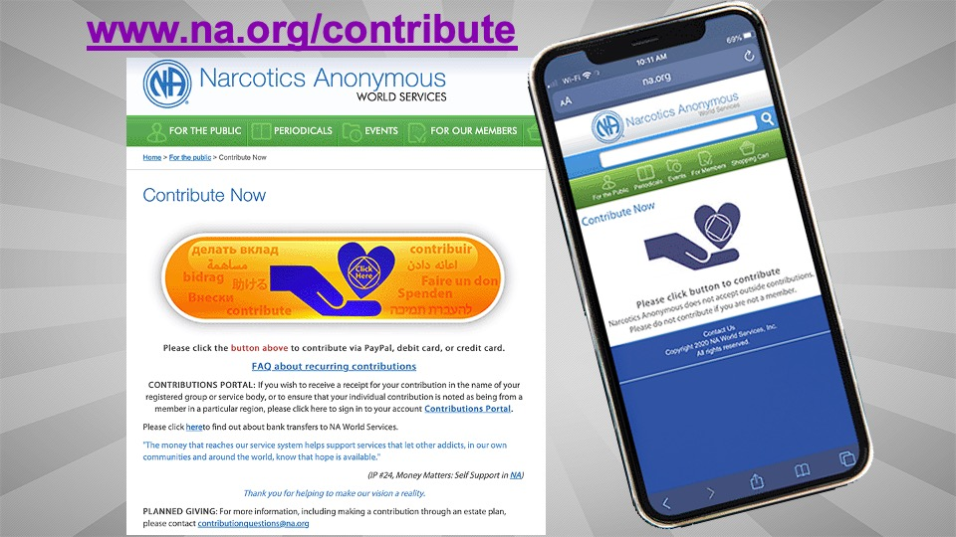
Notes:
This is the page we created last year to make it easier for people to contribute to World Services using PayPal or a credit card. You can find the page at na.org/contribute.
Be aware that if you want to be sure your contribution gets noted as coming from a particular group or service body, you will want to use the original contributions portal, which is shown as a link on this page.

Slide 16
Notes:
The original portal requires a log in so it’s not a one-click experience like this page, but it’s connected to our database so the specifics of each contributor are recorded. Both portals for contributing allow you to set up a recurring contribution. You can also link to both of these portals through the meeting finder app. If you don’t have it, I encourage you to get it and if you do have it, I encourage you to update it.
We appreciate every contribution we receive. Thank you all!

Slide 17
Notes:
One of the topics we get asked about most frequently is the World Convention.
We are in negotiations trying to reschedule WCNA 38 in Melbourne, Australia which was originally planned for September of this year. The challenge is that we don’t know what travel restrictions to and from Australia are going to look like in 6 or 7 months. Currently, people traveling from the US to Australia must quarantine for 14 days upon arrival. We have no idea what restrictions will or won’t be in place later this year. We are still hopeful that WCNA 38 will be able to be held in November of 2022 but we simply don’t know yet.
No matter what happens, we are still planning to hold the World Convention in Washington DC in 2024. Those dates are August 29 through 1 September. We are hoping that will be WCNA 39, but it’s possible it will be WCNA 38. More will be revealed.

Slide 18
Notes:
Everything we do in World Services is about and motivated by Fellowship development. We are holding another webinar next month on May 1st – Service Day – focused on Fellowship Development. On that webinar, we hope to be able to give you a broader picture of both NA World Services’ efforts and local efforts around the world to further the reach of our message. We want to try to meet in the regular zoom meeting platform so that we can all see each other. You can find more information about that web meeting at na.org/webinar

Slide 19
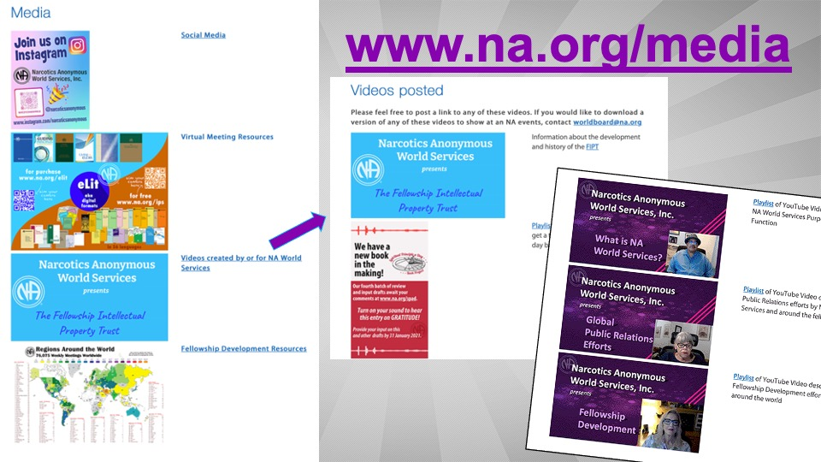
Notes:
You can find much longer videos about Fellowship development, What is NA World Services, and global PR efforts on the media page (www.na.org/media). These videos were made fairly early in the shut down, and we would love to remake them but there are simply not enough hours or staff to get that done yet.
Even with no travel and fewer people, we have virtually visited many places in the first few months of 2021—the European Delegates Meeting, the Asia Pacific Forum, Western States Zonal Forum, the Autonomy zone, the Polish region, and next weekend, the Florida Service Symposium.

Slide 20
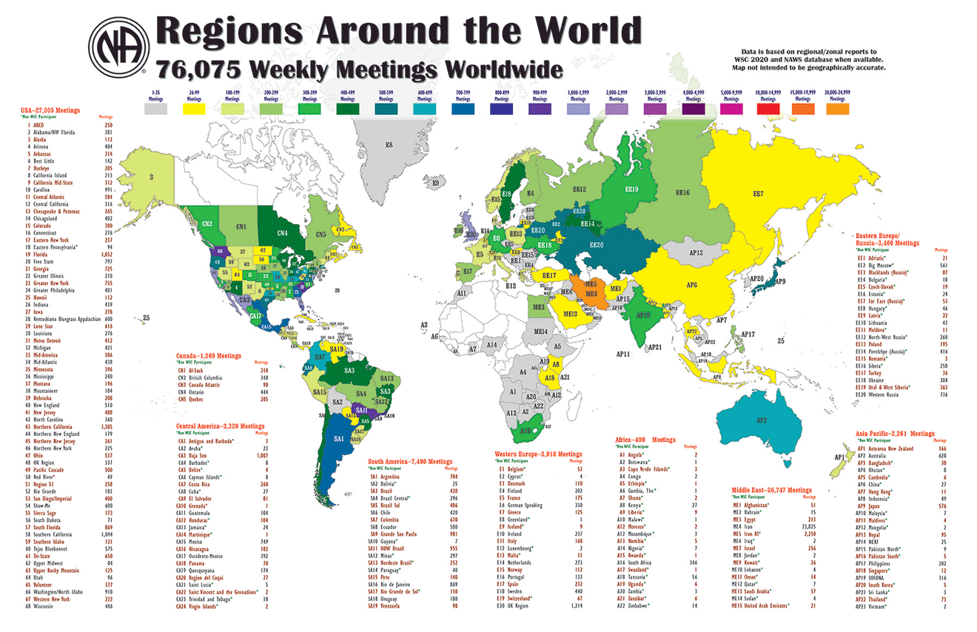
Notes:
Before the global shut-downs changed everything, there were more than 76,000 NA meetings weekly around the world.
But there’s still a lot to do. The white places on this map are the countries where NA hasn’t yet reached. And there are many spaces within existing NA regions where there are no meetings yet.
So many efforts are happening to color in this map and its life changing message around the world

Slide 21
Notes:
New virtual meetings have just begun in Morocco, Yemen, and Tunisia. We just got these pictures of the meeting in Sudan celebrating its 4th anniversary.
We still have a lot of work to do.

Slide 22
Notes:
This map shows the 91 languages NA members speak.
We publish literature now in 56 of those languages! Georgian was our most recent addition. During the last calendar year, we published more than 100 new pieces of translated literature, bringing the total number of translated pieces to 1,276.
Local members do the heavy lifting in almost all translations, with very few exceptions. It takes dedicated members willing to devote countless hours to the work, even when a professional translator is used. We oversee translations to make sure conceptual fidelity to the literature is maintained, and we organize proofing, copyrights, layout, and production. For almost a year, we’ve had a translations staff of one and a production staff of one—now one and a half.

Slide 23
Notes:
Having literature in your own language saves lives. It helps addicts hear our message and, to quote one of the stories in the Basic Text [What Makes Me Happy Now], it shows addicts that they are “sharing the same experience as members around the world.”
Every year, we give away or subsidize hundreds of thousands of dollars of literature to help NA grow around the world.

Slide 24
Notes:
This graph represents the cost of free and subsidized literature that NAWS distributes to communities around the world.
You can see that in the 2019 fiscal year, we distributed more than we ever have before—more than $832,000 dollars worth. In the last fiscal year, the total was just shy of $580,000. In the last approximately 100 days, since the end of November, we have published 29 translated items in 12 languages and shipped free literature to over 15 different countries – including to incarcerated members and other locations in the US.
We don’t report many of the details of where this literature goes for a couple of reasons. One reason is motivated by the spirit of anonymity and a desire to not embarrass those communities. When we highlighted East Africa in the past, they were suddenly inundated with some very poorly translated Swahili baby blue texts at a time when they were trying to come to consensus about what the NA message was in Swahili. We never want to cause a community confusion or harm, even inadvertently. We will let some of the communities tell you some of these amazing stories themselves in May. None of these efforts would be possible without the support NA World Services has received from the Fellowship during the pandemic.

Slide 25
Notes:
In the same ongoing effort to make our message available, we have also been posting free audio versions of the Basic Text as they become available.
So far, we have Arabic, Hungarian, Russian, Spanish, and Thai posted. And we are very happy to announce that we just posted the English version of the 5th Edition. I’m not sure when we will be able to finish the 6th edition in English, Spanish, or Russian, but we will post it when we do.
If you click the literature icon on the front screen of na.org, you’ll see a link for the audio Basic Texts. You can also simply search for audio in the search bar at the top of na.org.
From the literature page, you can also find IPs and booklets and reading cards in 56 languages. The shortcut address for that page is na.org/ips
At the bottom of the literature page is a link to our webstore and to information about purchasing electronic copies of our literature. The shortcut address for those two pages is na.org/webstore and na.org/elit.

Slide 26
Notes:
In addition to publishing and distributing literature and all of the many, many other things we do, one of World Services most important jobs is to protect NAs intellectual property for the current and future Fellowship. Intellectual property is a legal term for things like writing or music that were created by the human mind. In the case of NA, our intellectual property is our recovery literature and our trademarks, and those are protected by the Fellowship Intellectual Property Trust (or FIPT).
The FIPT is a legal document that contains the collective decisions the NA Fellowship has made to preserve the integrity of our published message and the accountability of our publishing services. The Fellowship of Narcotics Anonymous, as given voice by its groups through their regional delegates at the World Service Conference, created and makes decisions about the trust. NA World Services, Inc. manages the trust on their behalf, and the Fellowship of Narcotics Anonymous as a whole is the beneficiary.
The last World Service Conference passed a project to revise the FIPT legal document to reflect a recent Conference decision that made zonal delegates voting members of the World Service Conference. It is a pretty straightforward revision, and it is posted for Fellowship review until the end of May on the FIPT page (www.na.org/fipt).
We will review the input from the Fellowship after May, and the proposed changes to the FIPT will be included in the next Conference Agenda Report for approval at the 2022 World Service Conference.

Slide 27
Notes:
There is a lot of misinformation about the FIPT. Here is what the document itself says. The purpose of the trust is:
“to hold and administer all recovery literature and other intellectual properties of the Fellowship of Narcotics Anonymous in a manner that will help addicts find recovery from the disease of addiction and carry that message of recovery to the addict who still suffers, in keeping with the Twelve Steps and Twelve Traditions of NA.”
We’ve posted a short video at the top of the FIPT page to help explain what the Fellowship Intellectual Property Trust is and why it is important. We have the video posted in English currently, with Spanish on the way and Portuguese in process. This is not a topic that most members really think about but it is critical that NA material remain the property of NA, that our literature contains the language approved by NA members. Our intellectual property is a legacy we protect for those who come after us.
The World Board offered several motions in the last Conference Agenda Report, or CAR for short, about the FIPT Operational Rules and bulletins, and is working on the current revisions mentioned in the last slide. There will be several motions offered in the next Conference Agenda Report later this year.

Slide 28
Notes:
If you’re subscribed to NAWS News or the Just for Today emails, you received a NAWS Update email that announced a new survey we have posted. One of the things NAWS’ PR department does is cooperates with researchers who are “friends of NA.” These professionals want to tell their peers about NA’s success as a viable program of recovery. And they are able to be “heard” by professionals because they are speaking peer to peer.
And those professionals, in turn, will learn of NA’s credibility and be more likely to refer addicts to NA. It’s really just all about carrying the message.
We had over 3,500 responses to an earlier survey we posted from these same researchers on NA’s response to the pandemic. Presently, the article from this earlier survey is being submitted for publication. We will report when the article is published.
This current survey seeks to find out what tools benefit NA members in our recovery journey. The researchers only provided us the survey in English, so we are only able to post it in English. We hope that each of you will not only take the time to complete the survey, but will encourage at least a couple of your friends to do the same. You can find that survey at na.org/survey.

Slide 29
Notes:
Another service we do is hold regular web meetings for trusted servants involved in PR work, including Inmate Step Writing, PR, Zonal PR efforts, Phonelines, and H&I. This is not new. Most of the meetings are quarterly, and we’ve been doing it for years. You can find a complete list at na.org/webinar.
The members who attend seem to really enjoy the meetings. Most of the meetings are focused on members talking to each other and sharing successes and challenges. They continue to grow as we all adapt to a virtual world.
If you’re doing PR service work, and are interested, send an email to pr@na.org and we will keep you updated about dates and topics.

Slide 30
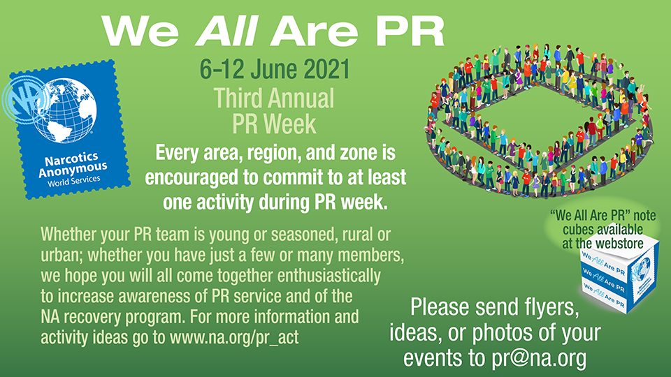
Notes:
You may have heard of PR week. This is the third annual PR week, which is the first full week of June, 6-12 in 2021. The purpose of the week is to generate enthusiasm in NA for PR service work, have some fun and to do some PR initiatives. We have heard from many communities who plan to celebrate. Everyone takes a different approach. This year, we have heard some communities are building videos for professionals; “We ALL are PR” is the theme for PR Week. Members in a zone will be sharing their experiences at a National Conference; and a speaker jam about PR service that will include international speakers and will be face to face and virtual.

Slide 31
Notes:
This is an initiative that carries the message of recovery to parolees. PR members formed a relationship with the parole supervisor, and through COVID, online meetings began. One such meeting attracts 300+ parolees per night. Presently, these meetings are in California, and there is a Spanish speaking parolee meeting in Texas. Perhaps these meetings may grow in other locales and reach more parolees.

Slide 32
Notes:
Our newest IP, #30, Mental Health and Recovery is one of our pamphlets that can be great to distribute to professionals when you’re doing PR service work, and it also fills a much-needed role for NA members and potential members.
You can read it and download it from na.org/ips or purchase copies from na.org/webstore.

Slide 33
Notes:
On the subject of literature, the 2018 World Service Conference approved plans for a Spiritual Principle a Day Book Project, and we will have a draft for approval in the 2022 Conference Agenda Report, which will come out in English this November. You can still contribute and be a part of creating NA literature!

Slide 34
Notes:
There are two ways in which any member can help with this project:
The first is to submit your writing about a spiritual principle. As you may know, all of the drafts start with the source material we get from members. We hope you’ll take the time to send us some of your writing.
The second way to contribute is by participating in “review and input” (R&I). Our fifth batch of R&I drafts is available now, and we will have one final batch in June.
Based on the input we’ve received so far, we think we have a great book in the making, one that’s written “by us and for us.“ As with Just for Today, not every page will speak to every member, but everyone should be able to find some inspiration in the book.

Slide 35
Notes:
Here is one of the SPAD entries being read. We made this recording for an Instagram post, and you can find it there (www.Instagram.com/narcoticsanonymous) or in the video section of our media page.
(If the sound does not come on automatically, click the sound icon in the lower-left hand corner of the screen to hear the entry being read.)

Slide 38
Notes:
The last batch of spiritual principles have been posted for members to write on at www.na.org/spad. Don’t worry too much about style or length—we read everything you send, and your ideas are what’s most important.
And the fifth of six batches of entries to review is posted until the end of May.
Thank you to everyone who has sent writing and input and ideas so far. Anyone can contribute to the project. We hope you’ll send some writing in the coming days or give us some input on the drafts that are posted now and those that we’ll have for you in June. Thanks!

Slide 39
Notes:
Our Instagram handle is @narcoticsanonymous.
Check it out if you haven’t already

Slide 40
Notes:
This is our new Media page. We’ve collected some of our videos, social media memes, and frequently requested images and resources here. Like the Virtual Meeting Resources page, we regularly add to the collection. This should make it easy for members to download, repost, and share this material.
Other places for resources and information on our website include:
Na.org/aboutus
For a general overview of World Services’ activity, including a version of this presentation, head to na.org/aboutus and find the PowerPoint on that page. You can get there by clicking the question mark on the front page of the site.
Na.org/ar
Another great source for an overview, is our Annual Report. Go to na.org/ar or select NAWS Annual Reports from the Periodicals drop-down menu. You’ll see there is a long version of the report and a shorter, “in brief” version.
Na.org/nawsnews
For more current activity, go to the NAWS News page at na.org/nawsnews. Again, you can find this from the Periodical drop-down menu. There you’ll see NAWS News plus the NAWS Update emails we send to our large distribution list. If you want to sign up to get those emails, go to na.org/subscribe and subscribe to either the daily Just for Today reading or NAWS News.

Slide 41
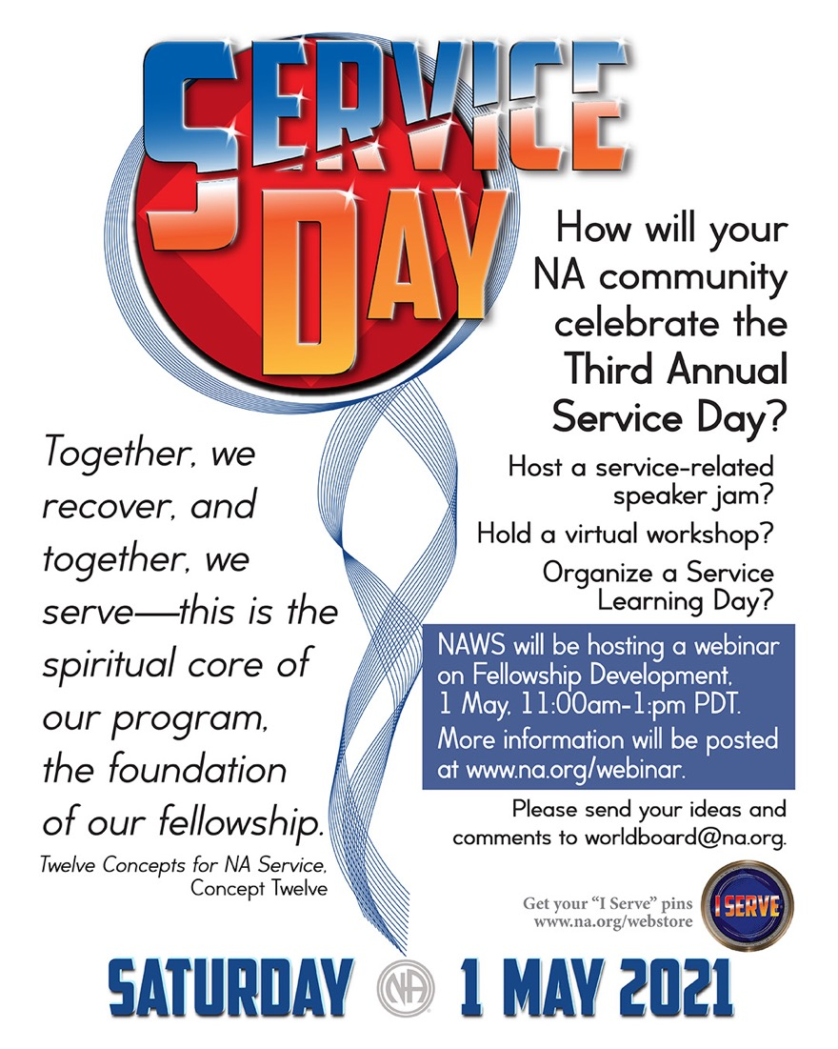
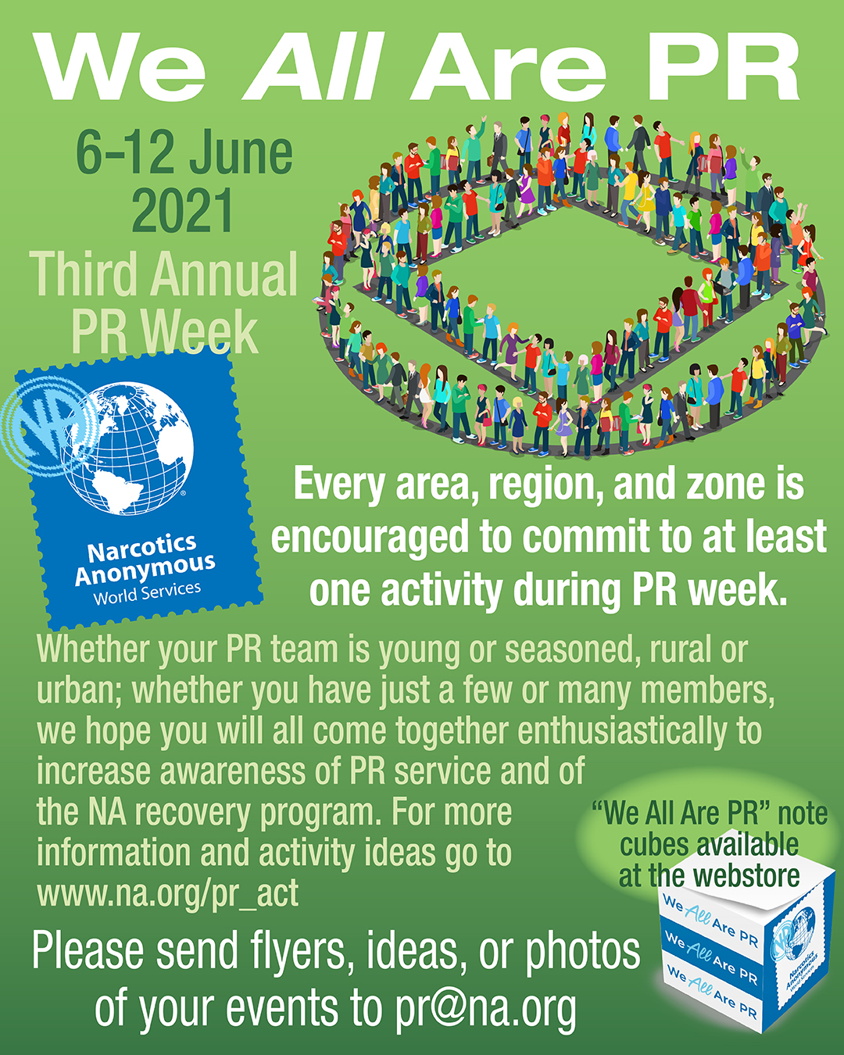
Notes:
Don’t forget:
Service Day is coming up : 1 May
We are planning an FD webinar on May 1st, with members from all over telling service stories.
Public Relations Week: is the first week of June. If you’re planning an event, write to pr@na.org and let us know.
Thank you everyone for everything you do for NA.

