Slide 1
The UKNA Survey – what we know so far

Slide 2
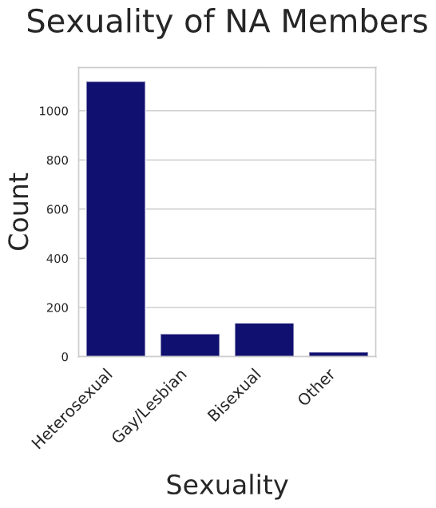
The Basics
Sexuality
How Many?
Number of Surveys Completed | 1916
Number of Usable Reponses | 1420
Age
Average Member Age (Mean) | 47
Oldest member | 81
Youngest Member | 15
Notes:
1422 responses were over 40% complete, and 2 responses were dropped as ‘troll’ responses
LGBT stats –UK pop 93.2 self report as straight – for us it’s 79.26

Slide 3
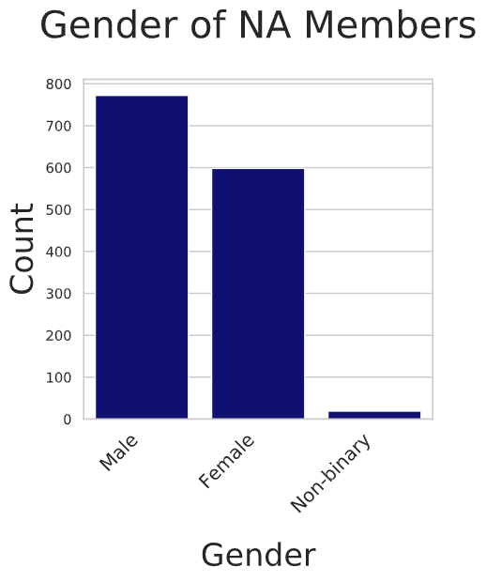
The Basics
Ethnicity
Asian/ Asian British
Indian | 0.93
Pakistani | 0.36
Bangladeshi | 0.07
Chinese | 0
Any other Asian background | 0.5
Black/ African/ Caribbean/ Black British
African | 0.78
Caribbean | 1.14
Any other Black/ African/ Caribbean background | 0.43
Other ethnic group
Arab | 0.21
Any other ethnic group | 0.78
Gender
Ethnic Group | %
White
British / English / Welsh / Scottish / Northern Irish | 79.03
Irish | 3.28
Gypsy or Irish Traveller | 0.5
Any other White background | 7.56
Mixed/ Multiple ethnic groups
White and Black Caribbean | 0.64
White and Black African | 0
White and Asian | 1.07
Any other Mixed/ Multiple ethnic background | 1.85
Notes:
Non-binary above UK (0.4 vs 1.35)

Slide 4
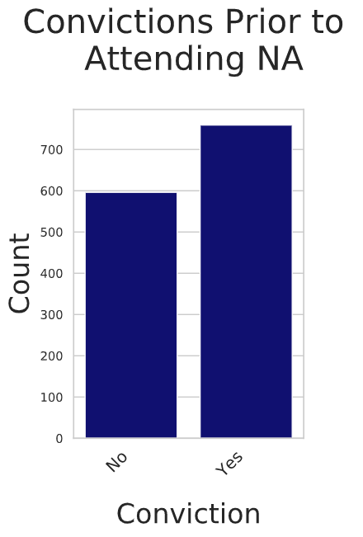
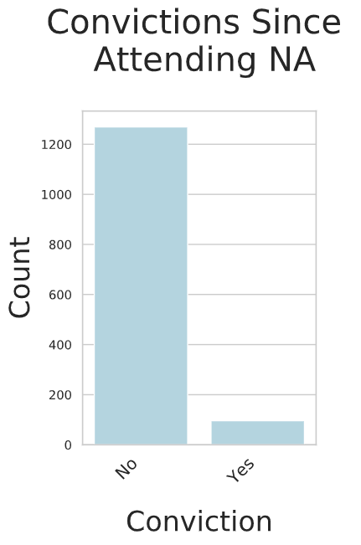
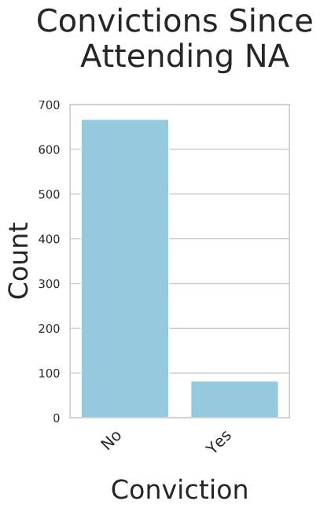
Recovery and Convictions
Convictions post NA for the previously convicted group
Convictions before NA
Convictions post NA
Notes:
Convictions before 53.16 Yes 43.31 No
Convictions after 6.96% Yes 92.09 % No
For the previously convicted group 10.83% Yes 88.11 No

Slide 5
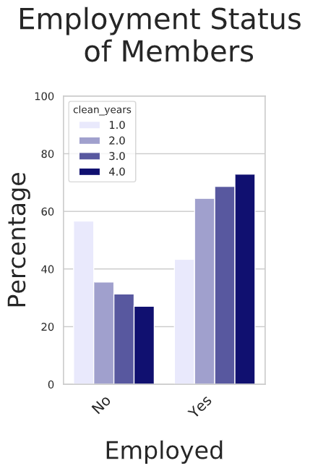
Employment
Headline Numbers
% of members employed | 64.18%
% of members employed with over three years clean | 77.62%
UK employment | 76.4%
Notes:
When we look at members over three years clean, we have 77.62 employment (above UK figure)

Slide 6
Time Clean
9 1/2 years
Almost 40% of respondents said they had been using for over 20 years before they came to NA. Of these members, average clean time was 8 years.
Mean cleantime for all respondents
4,875,953 days
Combined cleantime in days of all members who took part

Slide 7
Looking Ahead
There is more to come - all the variables that were on the last survey, plus more.
I hope to have completed data analysis by the end of October, and a draft report ready for November Region.

Slide 8
Any Questions?

